Slide 1

AI & The Future of Mathematics
Reflections on OpenAI’s Navier-Stokes Announcement
Mingyang Han
DSAN6725
2026.09.15
AI & Mathematics Briefing
Slide 1 of 10

Slide 2
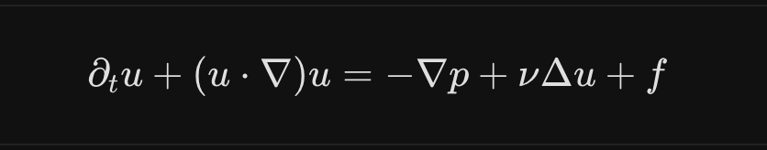

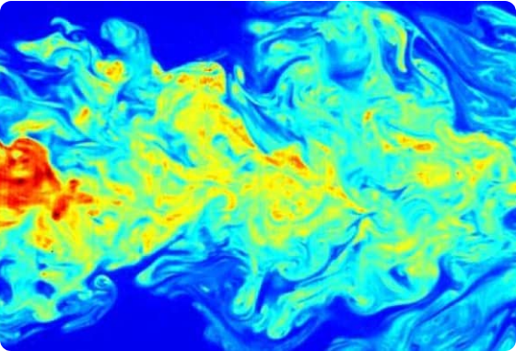
OpenAI's Navier-Stokes Claim
In September 2026, OpenAI announced that an internal AI system derived a proof for the 90-year-old Navier-Stokes Millennium Problem.
The Core Problem: The Navier-Stokes equations describe fluid motion (water, air, blood flow). The question asks whether smooth solutions always remain smooth or form singularities (infinite velocity).
OpenAI's Finding: The AI produced a counterexample proof showing a spinning vortex can form a singularity in finite time with finite total energy.
Lean Verification: The analytical proof was formalized and verified in 17 hours using the computer proof assistant Lean.
Navier-Stokes Millennium Problem
Slide 2 of 10

Slide 3


Scale of the Computational Effort
To solve the problem, OpenAI deployed unprecedented parallel AI agent architecture:
10,000
88 hrs
130B
~$10M
CONCURRENT AI AGENTS
TO REACH SOLUTION
OUTPUT TOKENS
ESTIMATED COMPUTE COST
"The agents exchanged 2.7 million messages, brainstormed strategies, and wrote code until converging on a finite-time blowup proof."
— OpenAI Research Team (September 2026)
Computational Scale & Resources
Slide 3 of 10

Slide 4


Can AI Brute-Force Goldbach?
A Natural Reflection
If massive multi-agent AI systems can burn millions of dollars to search high-dimensional space and solve Navier-Stokes, can we use brute force to tackle other unsolved mysteries like Goldbach's Conjecture?
The Infinite Dilemma
Checking 10^18 instances does not guarantee the 1019th case holds.
A single counterexample at 10^200 would shatter the conjecture completely.
Every even integer greater than 2 can be expressed as the sum of two prime numbers.
10 = 3 + 7 = 5 + 5
100 = 3 + 97 = 11 + 89 = 17 + 83
Verification vs. Proof: Computers have checked numbers up to 10^18 without finding a single exception. But in pure mathematics, empirical verification is never a proof.
Can brute-force AI agents find hidden counterexamples that human computation missed?
Reflections on AI Search
Slide 6 of 10

Slide 5

Euler's Sum of Powers Precedent
Euler's Conjecture (1769)
Computer Counterexample (1986)
Leonhard Euler conjectured that at least k terms of k-th powers are required to sum to another k-th power (e.g., for k = 4, at least four 4th powers are needed).
Noam Elkies used computer search algorithms to discover a massive counterexample for k = 4, instantly disproving Euler:
This conjecture stood unchallenged for over 200 years!
This historical lesson shows that long-held mathematical beliefs can be completely overturned by high-power computational search.
Historical Precedents in Computation
Slide 8 of 10

Slide 6

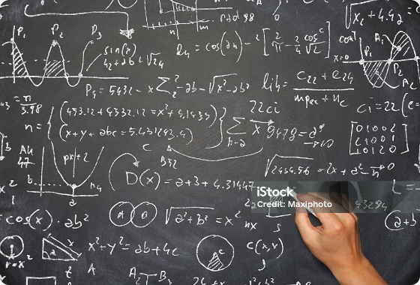

Open Letter: 25 Fields Medalists
25 Fields Medalists published a joint open letter condemning AI tech practices.
Central Warning
"AI corporations are treating deep mathematical problems as mere promotional benchmarks. This hype-driven approach is harmful to mathematical science and the global research community."
Mathematicians' Joint Response
Slide 4 of 10

Slide 7



Key Criticisms from Mathematicians
Unconsented Training
Bypassing Peer Review
Ignoring Prior Attribution
Protesting against using mathematicians' unpublished papers, drafts, and user sessions as AI training data without explicit consent.
Opposing "science by press release" where unverified proofs are broadcast directly to mass media before rigorous community peer review.
Failing to properly attribute human foundational work, concurrent human discoveries, or underlying prior mathematics relied upon by the AI.
Ethics & Community Concerns
Slide 5 of 10

Slide 8




The Future of Proof & Collaboration
Ethical AI Rules
AI as tool
Community Integrity
AI developers must respect academic consent, cite human prior work, and adhere to peer-review norms rather than media hype.
Combining AI's vast search power & Lean formal verification with human conceptual intuition and problem framing.
Mathematics thrives on shared understanding and trust—not black-box compute outputs without explanatory depth.
Thank You!
Conclusion & Outlook
Slide 10 of 10

